Slide 1
Platform Data – Layer → Tile schema Layers listing: https://pde.api.here.com/1/doc/layers.json?app_id={APP_ID}&app_code={APP_CODE}
Layer n
Tile | Tile | Tile | Tile | Tile | Tile | Tile | Tile | Tile | Tile
Tile | Tile | Tile | Tile | Tile | Tile | Tile | Tile | Tile | Tile
Tile | Tile | Tile | Tile | Tile | Tile | Tile | Tile | Tile | Tile
Tile | Tile | Tile | Tile | Tile | Tile | Tile | Tile | Tile | Tile
Tile | Tile | Tile | Tile | Tile | Tile | Tile | Tile | Tile | Tile
Tile | Tile | Tile | Tile | Tile | Tile | Tile | Tile | Tile | Tile
Tile | Tile | Tile | Tile | Tile | Tile | Tile | Tile | Tile | Tile
Tile | Tile | Tile | Tile | Tile | Tile | Tile | Tile | Tile | Tile
Layer …
Layer 5
Layer 4
Layer 3
Layer 2
Layer 1
Platform Data

Slide 2
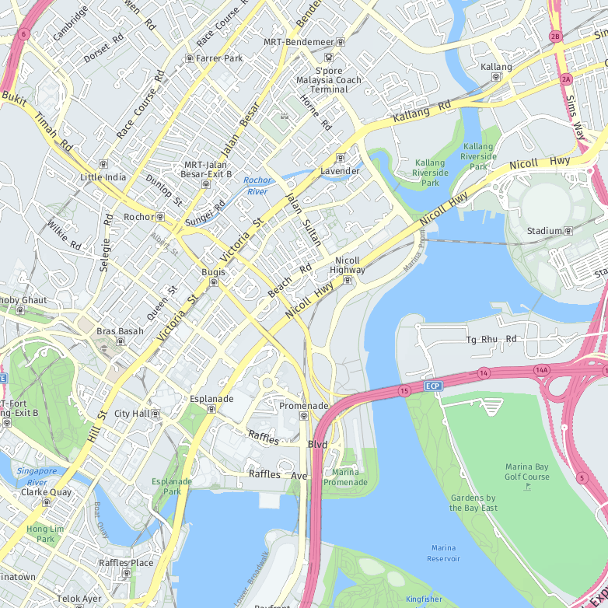
Platform Data Extension API - Proximity Search - Define a search center and radius to search geometries - Radius can be zero → point search - Search multiple layers with one request is possible Example: https://pde.api.here.com/1/search/proximity.json?app_id={APP_ID}&app_code={APP_CODE}&layer_ids=ADMIN_POLY_1&key_attributes=NAME&proximity=1.3030369,103.8622178,500
Tile | Tile | Tile | Tile | Tile | Tile | Tile | Tile | Tile | Tile
Tile | Tile | Tile | Tile | Tile | Tile | Tile | Tile | Tile | Tile
Tile | Tile | Tile | Tile | Tile | Tile | Tile | Tile | Tile | Tile
Tile | Tile | Tile | Tile | Tile | Tile | Tile | Tile | Tile | Tile
Tile | Tile | Tile | Tile | Tile | Tile | Tile | Tile | Tile | Tile
Tile | Tile | Tile | Tile | Tile | Tile | Tile | Tile | Tile | Tile
Tile | Tile | Tile | Tile | Tile | Tile | Tile | Tile | Tile | Tile
Tile | Tile | Tile | Tile | Tile | Tile | Tile | Tile | Tile | Tile
JSON Result:
{
"geometries": [
{
"distance": -99999999,
"attributes": {
"ADMIN_LEVEL": "2",
"SOURCE_TYPE": "P",
"FEATURE_TYPE": "900170",
"CARTO_ID": "37881321",
"ADMIN_ORDER": "1",
"ADMIN_PLACE_ID": "21160516",
"NAME": "Singapore"
},
"nearestLat": 0.0,
"nearestLon": 0.0,
"layerId": "ADMIN_POLY_1",
"geometry": "MULTIPOLYGON(((103.87809 1.27951,103.87782 ……,0103.87809 1.33349,103.87809 1.27951)))"
}
]
}
Center
(lat/lng)
Radius
(meters)

Slide 3
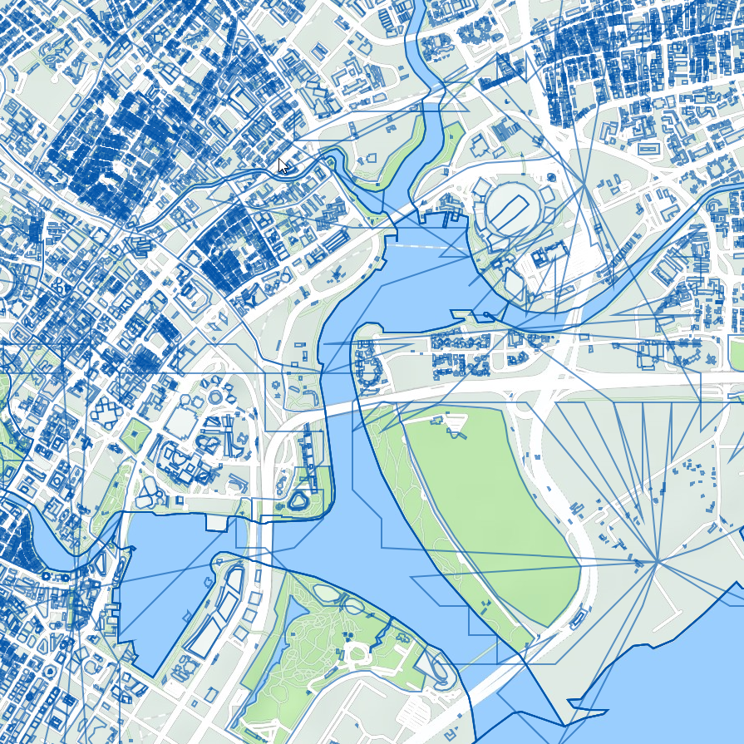
How To Make A Polygon Identifier - Select carto layers - Define key attributes - Define a search center Example: https://pde.cit.api.here.com/1/search/proximity.json?app_id={APP_ID}&app_code={APP_CODE}&layer_ids=ADMIN_POLY_0,ADMIN_POLY_1,ADMIN_POLY_2,ADMIN_POLY_8,ADMIN_POLY_9,BUILDING,CARTO_POLY_DO1,CARTO_POLY_DO2,CARTO_POLY_DO3,CARTO_POLY_DO4,CARTO_POLY_OCEAN,CARTO_POLY_RIVER_DO1,CARTO_POLY_RIVER_DO2,CARTO_POLY_RIVER_DO3,CARTO_POLY_RIVER_DO4&proximity=1.2959355999510354,103.8654905946903&key_attributes=FEATURE_TYPE,FEATURE_TYPE,FEATURE_TYPE,FEATURE_TYPE,FEATURE_TYPE,FEATURE_TYPE,FEATURE_TYPE,FEATURE_TYPE,FEATURE_TYPE,FEATURE_TYPE,FEATURE_TYPE,FEATURE_TYPE,FEATURE_TYPE,FEATURE_TYPE,FEATURE_TYPE
JSON Result:
{
"geometries": [
{
"distance": -99999999,
"attributes": {
"ADMIN_LEVEL": "1",
"SOURCE_TYPE": "L",
"FEATURE_TYPE": "907196",
"CARTO_ID": "739190588",
"ADMIN_ORDER": "0",
"ADMIN_PLACE_ID": "21160468",
"NAME": "Singapore"
},
...
},
{
"distance": -99999999,
"attributes": {
"ADMIN_LEVEL": "2",
"SOURCE_TYPE": "P",
"FEATURE_TYPE": "900170",
"CARTO_ID": "37881321",
"ADMIN_ORDER": "1",
"ADMIN_PLACE_ID": "21160516",
"NAME": "Singapore"
},
...
},
{
"distance": -99999999,
"attributes": {
"NAMES": "ENGBNMarina Bay\u001e\u001e\u001dCHIBY滨海湾\u001ePYNBin Hai Wan",
"FEATURE_TYPE": "507116",
"CARTO_ID": "37879864",
"FACE_ID": "37879864"
},
...
}
]
}
Admin
1
Tile | Tile | Tile | Tile | Tile | Tile | Tile | Tile | Tile | Tile
Tile | Tile | Tile | Tile | Tile | Tile | Tile | Tile | Tile | Tile
Tile | Tile | Tile | Tile | Tile | Tile | Tile | Tile | Tile | Tile
Tile | Tile | Tile | Tile | Tile | Tile | Tile | Tile | Tile | Tile
Tile | Tile | Tile | Tile | Tile | Tile | Tile | Tile | Tile | Tile
Tile | Tile | Tile | Tile | Tile | Tile | Tile | Tile | Tile | Tile
Tile | Tile | Tile | Tile | Tile | Tile | Tile | Tile | Tile | Tile
Tile | Tile | Tile | Tile | Tile | Tile | Tile | Tile | Tile | Tile
Center
(lat/lng)
Admin
2
Harbor

Slide 4
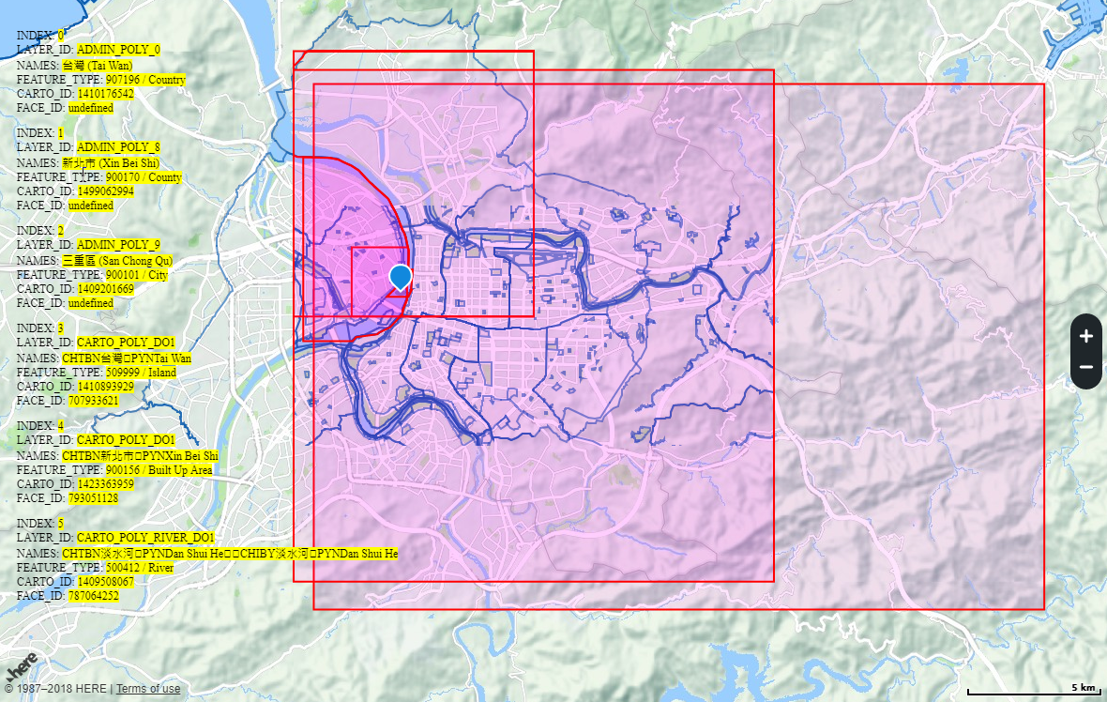
Demo https://aquawill.github.io/here_platform_ext_check_polygon_demo/

